Slide 1
Pfam: a protein family database
Bushra Haque

Slide 2
what is pfam?
Pfam is a database comprised of protein families and domains
A protein family is defined to be a group of proteins that share a common evolutionary origin
The evolutionary origin can be deduced from conserved sequences
Protein domains
(European Molecular Biology Laboratory, 2011)

Slide 3
Pfam database ENTRY
(European Molecular Biology Laboratory, 2011)

Slide 4
Profile hmm & hmmer
Profile HMMs use position-specific probabilistic modelling
HMMER is a webserver and a tool used to both create profile HMMs and search against other large databases
HMM Profile Logo
(European Molecular Biology Laboratory, 2011)

Slide 5
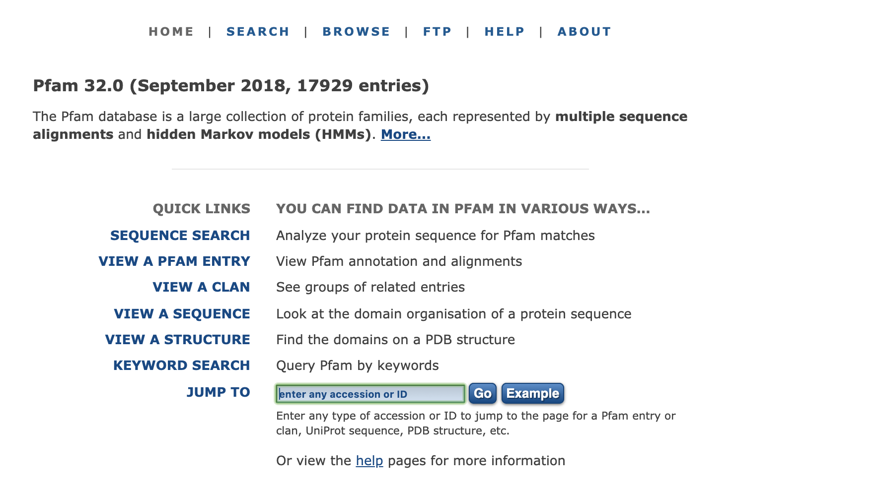
HOME PAGE
(El-Gebali et al., 2019)

Slide 6
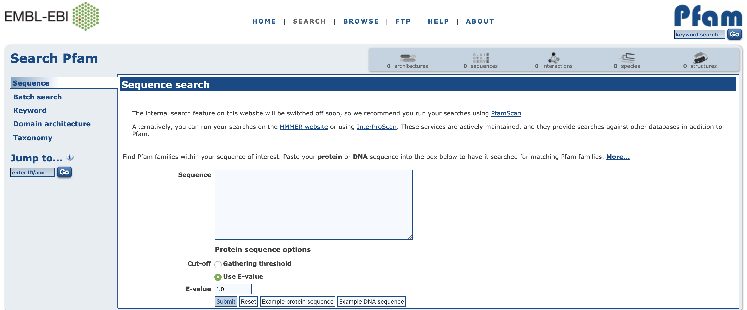
Searching with a Protein Sequence
(El-Gebali et al., 2019)

Slide 7
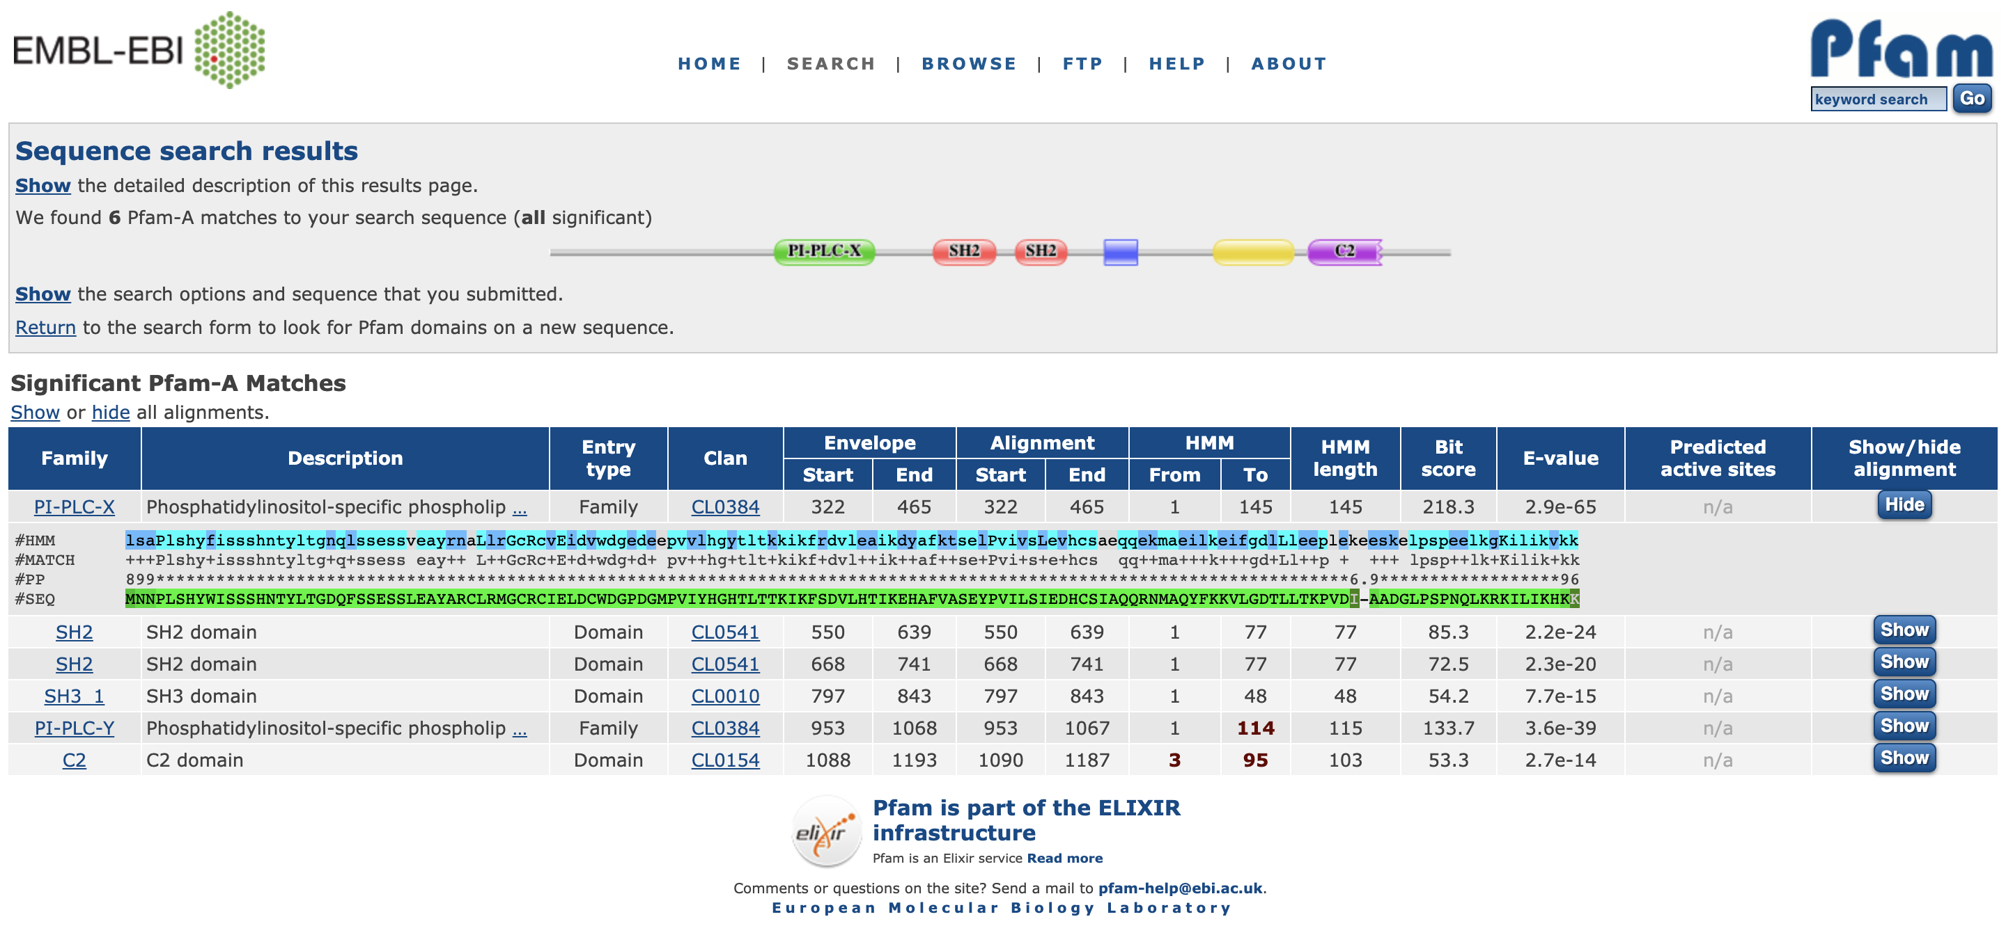
SEQUENCE RESULTS
(El-Gebali et al., 2019)

Slide 8
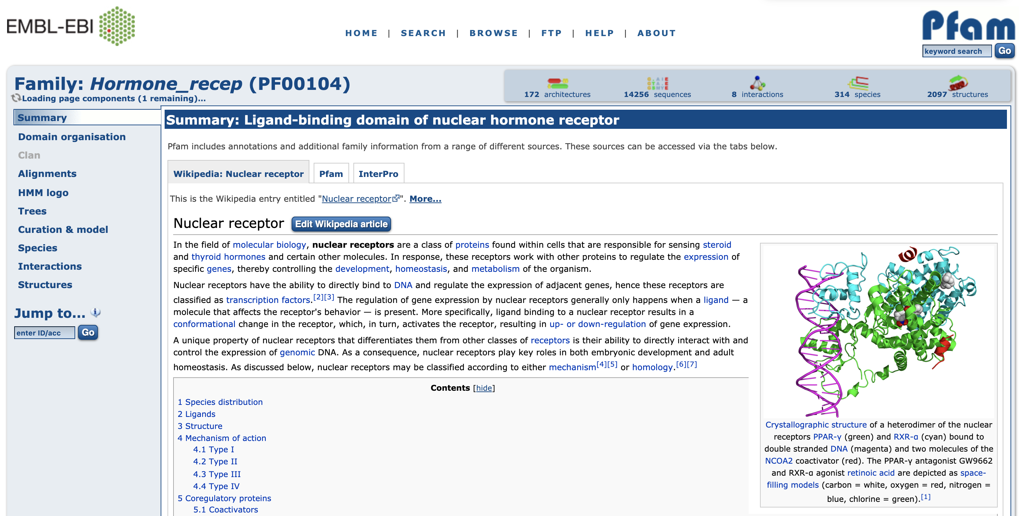
Searching with PFAM ENTRY NAME
(El-Gebali et al., 2019)

Slide 9

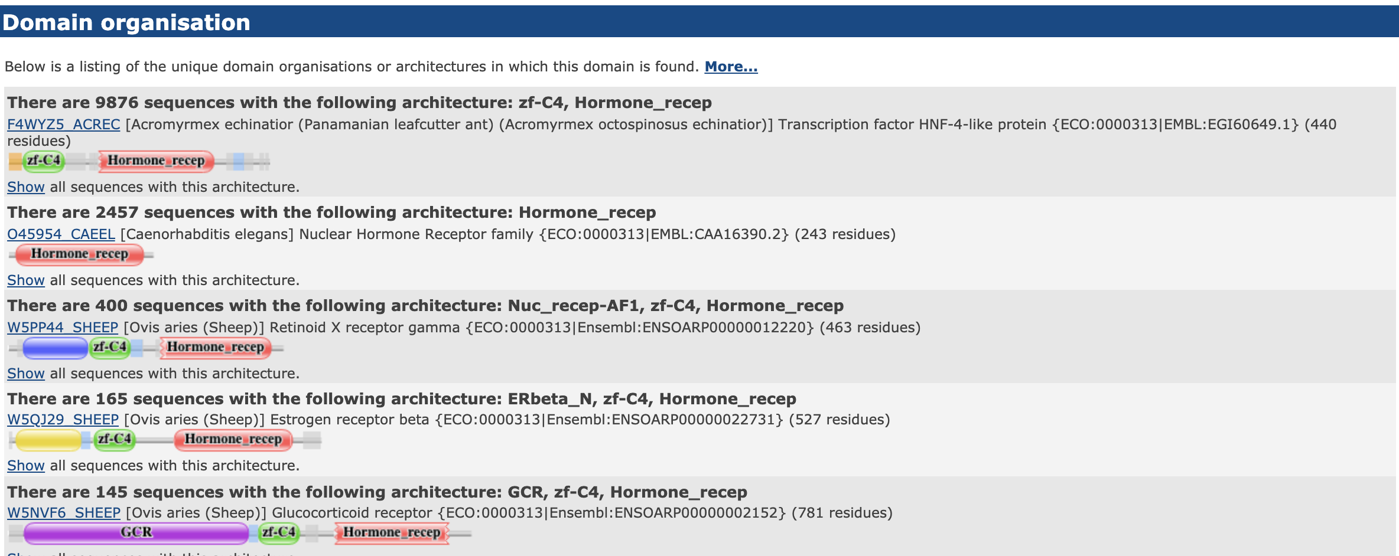
(El-Gebali et al., 2019)

Slide 10
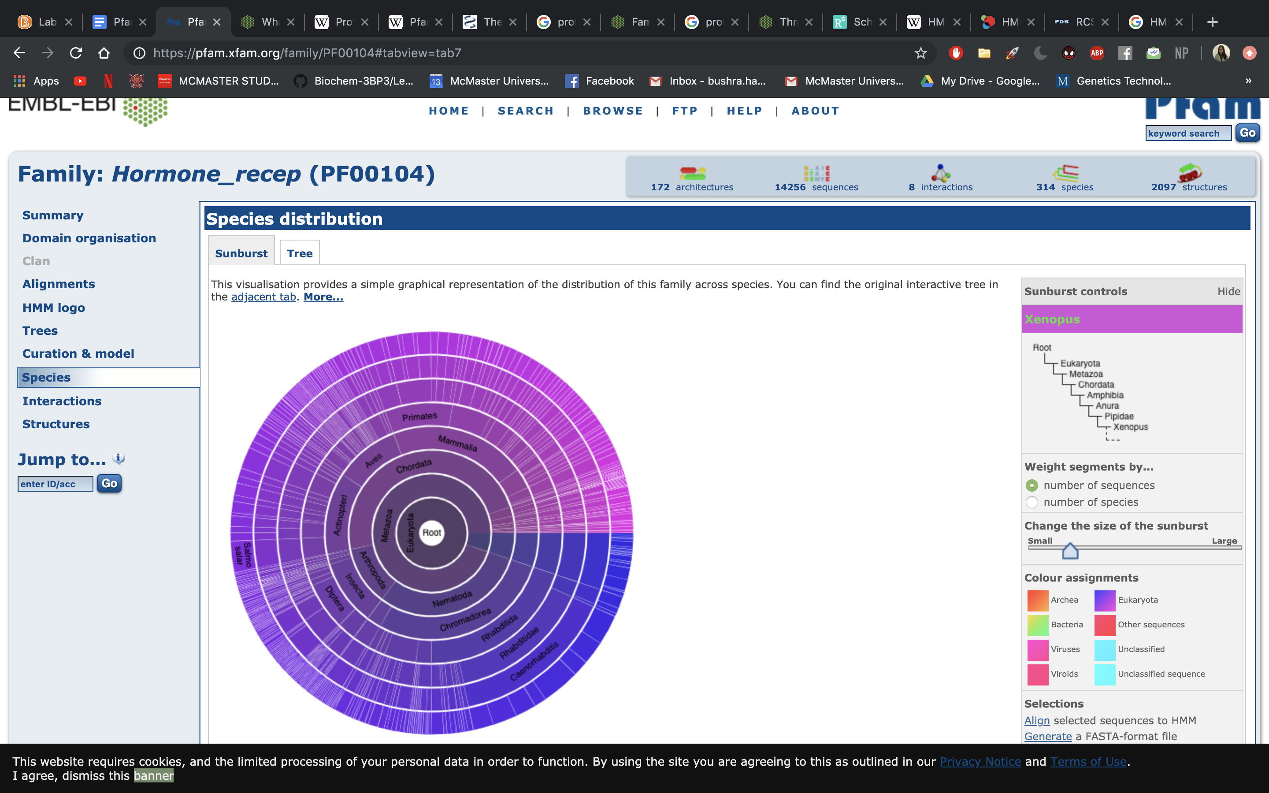
(El-Gebali et al., 2019)

Slide 11
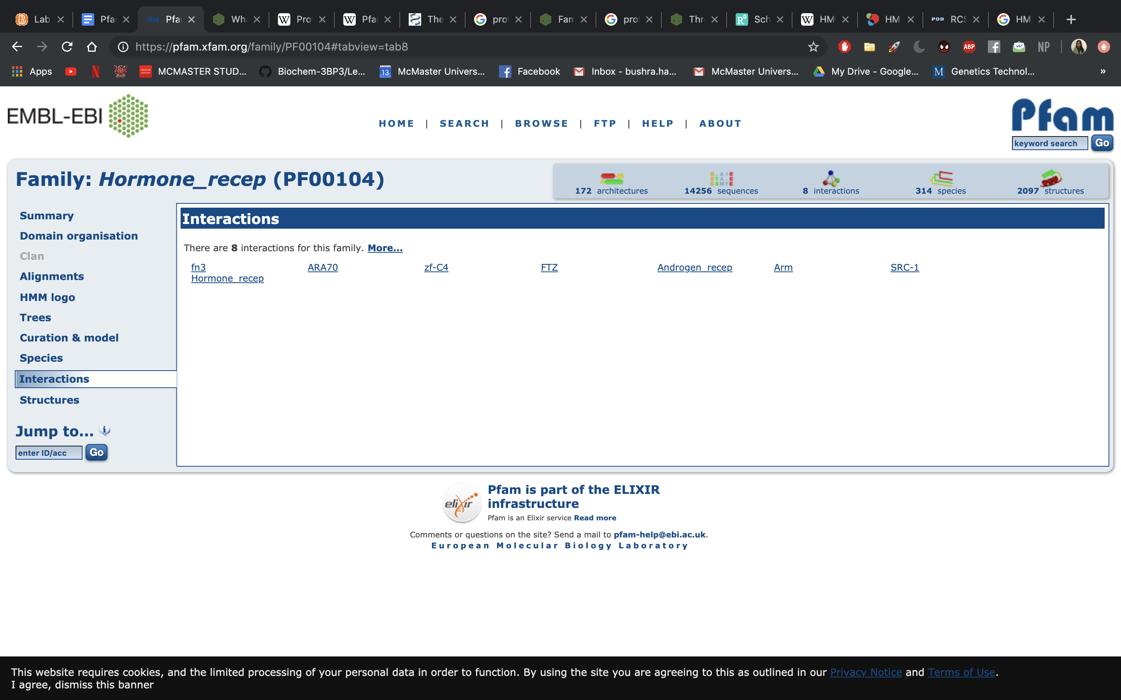
(El-Gebali et al., 2019)

Slide 12
Searching & Visualizing Structures
(El-Gebali et al., 2019)

Slide 13
(El-Gebali et al., 2019)

Slide 14
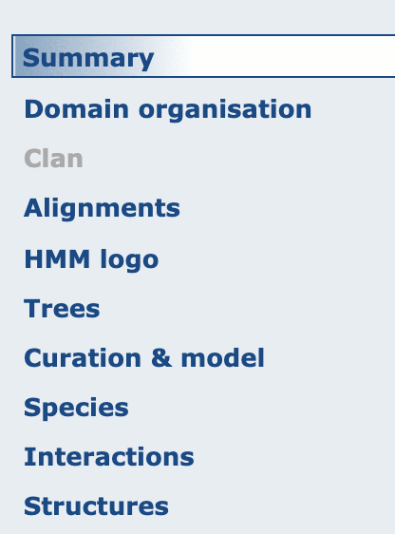
OBTAINING ALIGNMENT DATA
Viewing, formatting and downloading sequence alignments from ‘alignment’ tab
Download raw HMM profile from ‘curation & model’ tab
Retrieve sequence of a particular species from ‘species’ tab
(El-Gebali et al., 2019)

Slide 15
IMPORTANCE OF PFAM
Our ability to generate sequence data exceeds the rate at which we can characterize sequences through experiments
Computation methods are needed to identify regions of similarity between sequences
Contains a wide variety of tools and resources
Serves as a platform for researchers in the scientific community to collaborate

Slide 16
References
El-Gebali, S., Mistry, J., Bateman, A., Eddy, S. R., Luciani, A., Potter, S. C., … Finn, R. D. (2019). The Pfam protein families database in 2019. Nucleic Acids Research, 47(Database issue), D427–D432. https://doi.org/10.1093/nar/gky995
European Molecular Biology Laboratory. (2011a, November 18). Family- and domain-based protein classification. Retrieved September 14, 2019, from EMBL-EBI Train online website: https://www.ebi.ac.uk/training/online/course/introduction-protein-classification-ebi/protein-classification/family-and-domain-based-protei
European Molecular Biology Laboratory. (2011b, November 18). What are protein families? Retrieved September 14, 2019, from EMBL-EBI Train online website: https://www.ebi.ac.uk/training/online/course/introduction-protein-classification-ebi/protein-classification/what-are-protein-families
European Molecular Biology Laboratory. (2014, December 4). What is the Pfam resource? Retrieved September 14, 2019, from EMBL-EBI Train Online website: https://www.ebi.ac.uk/training/online/course/what-pfam
European Molecular Biology Laboratory. (2018a, March 26). Modelling in Pfam. Retrieved September 14, 2019, from EMBL-EBI Train online website: https://www.ebi.ac.uk/training/online/course/pfam-database-creating-protein-families/modelling-pfam
European Molecular Biology Laboratory. (2018b, March 26). What are profile hidden Markov models (HMMs). Retrieved September 14, 2019, from EMBL-EBI Train online website: https://www.ebi.ac.uk/training/online/course/pfam-database-creating-protein-families/what-are-profile-hidden-markov-models-hmms
Finn, R. D., Tate, J., Mistry, J., Coggill, P. C., Sammut, S. J., Hotz, H.-R., … Bateman, A. (2008). The Pfam protein families database. Nucleic Acids Research, 36(Database issue), D281–D288. https://doi.org/10.1093/nar/gkm960
Potter, S. C., Luciani, A., Eddy, S. R., Park, Y., Lopez, R., & Finn, R. D. (2018). HMMER web server: 2018 update. Nucleic Acids Research, 46(W1), W200–W204. https://doi.org/10.1093/nar/gky448
Sonnhammer, E. L. L., Eddy, S. R., Birney, E., Bateman, A., & Durbin, R. (1998). Pfam: Multiple sequence alignments and HMM-profiles of protein domains. Nucleic Acids Research, 26(1), 320–322. https://doi.org/10.1093/nar/26.1.320
Wheeler, T. J., Clements, J., Eddy, S. R., Hubley, R., Jones, T. A., Jurka, J., … Finn, R. D. (2013). Dfam: A database of repetitive DNA based on profile hidden Markov models. Nucleic Acids Research, 41(Database issue), D70-82. https://doi.org/10.1093/nar/gks1265

Slide 17
Kahoot
https://create.kahoot.it/share/pfam/b0b59e20-370a-4a64-92ed-a23056eb9675

Slide 18
Pfam database ENTRY
FILE | FUNCTION
Seed alignment | Manually verified multiple alignment of a representative set of sequences of the family
Profile hidden Markov model (HMM) | Built from the seed alignment for database searching and alignment purposes
Full alignment | Generated automatically from the seed profile HMM by searching large protein sequence database and aligning them to the HMM-profile Contains all detectable protein sequences belong to the family
Then classified into one of six types: family, domain, motif, repeat, coiled coil or disordered

